Slide 1
Analyzing Content Growth & Engagement of TWO Brands on Youtube
Presented By
BIBEK LAMSAL

Slide 2
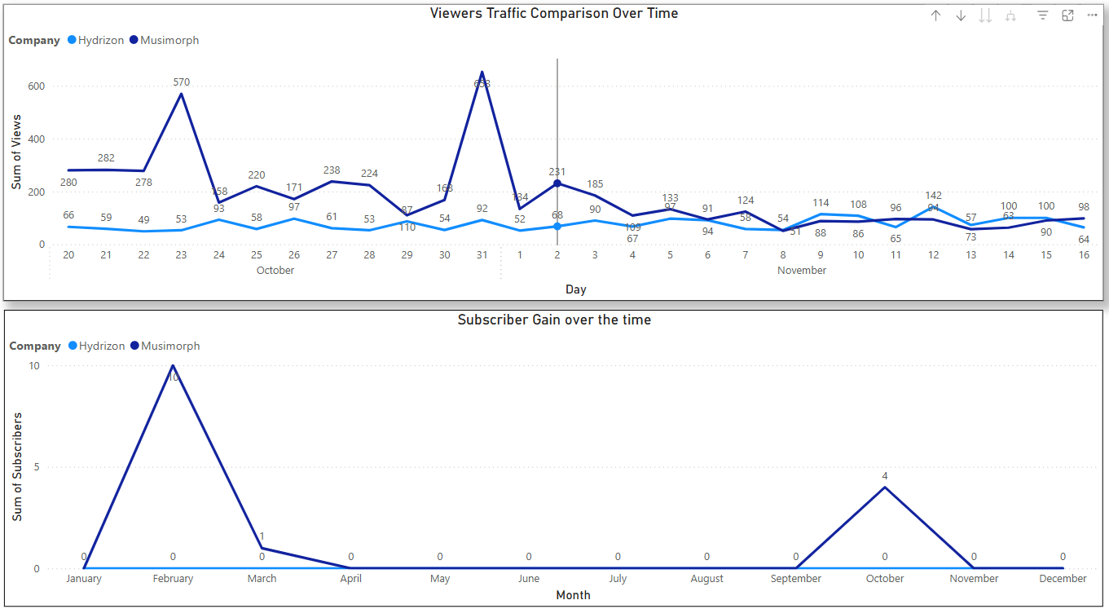
Visualization using dashboard

Slide 3
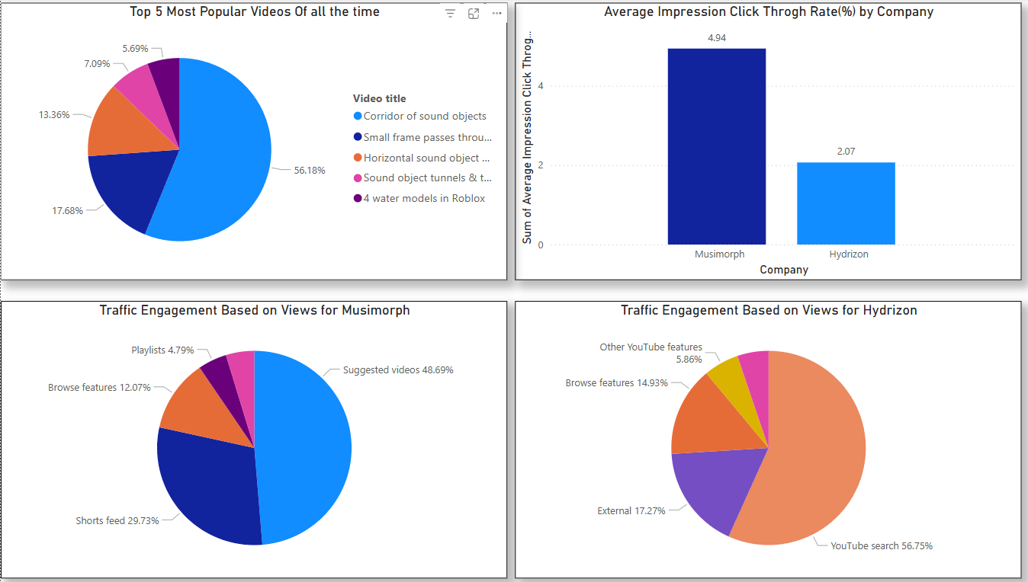

Slide 4
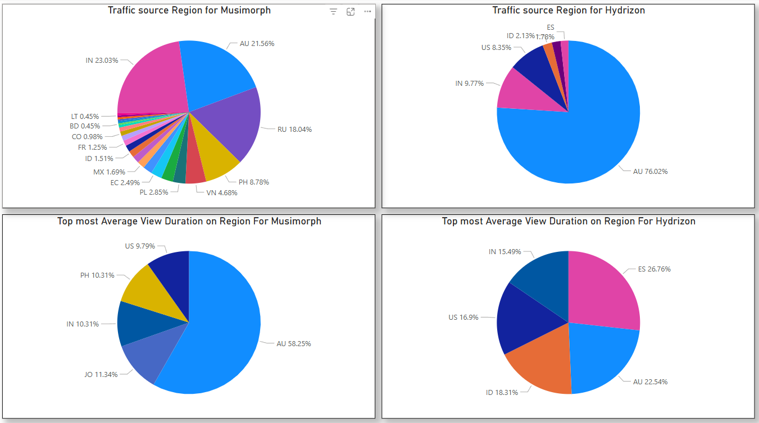

Slide 5
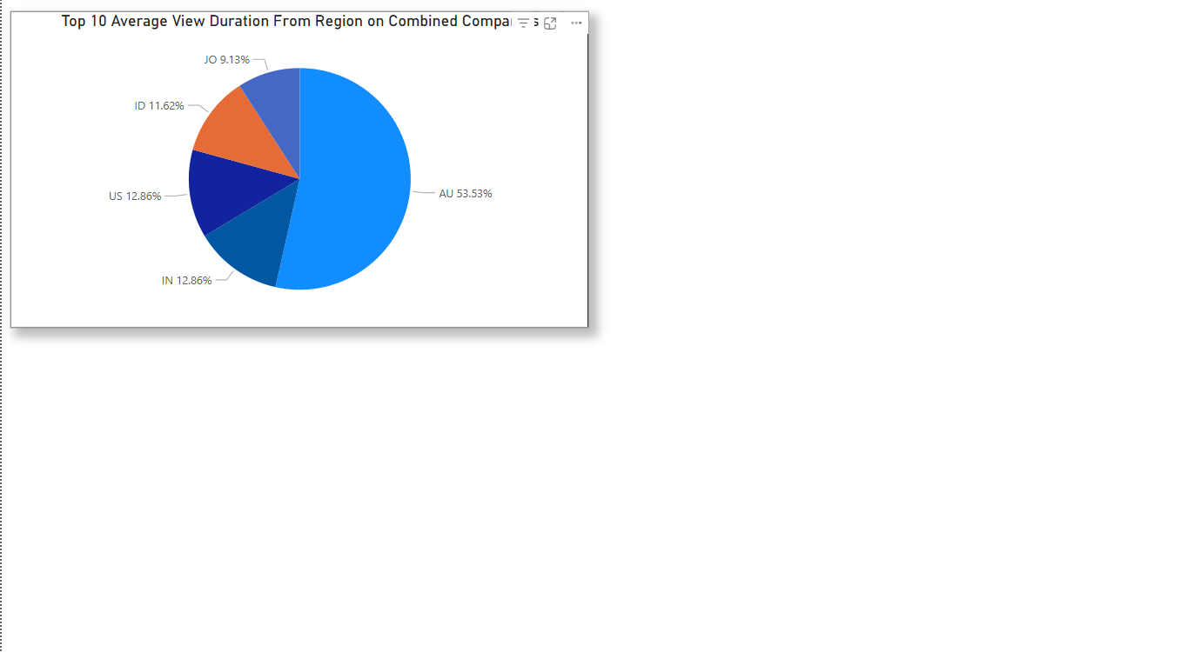

Slide 6
Insight:
Musimorph's Market Leadership: Musimorph outperforms Hydrizon in total views and subscriber growth, with Hydrizon experiencing minimal to no subscriber gain over time..
Higher Engagement Through Click-Through Rate (CTR): Musimorph maintains a strong impression click-through rate of 4.94% on average, significantly outperforming Hydrizon's 2.07%
Media Based Traffic Sources: Around 80% of traffic comes from YouTube search, Shorts feeds, playlists, and browse features, highlighting the importance of search optimization and engaging short-form content.
Regional Audience Distribution Based On Views: Australia (32.48%), India (20.37%), and Russia (14.42%) are the top traffic sources of total views.
Regional Audience Distribution Based on Average View Duration: Australia (53.53%), India (12.86%), and the US (12.86%) account for the highest viewership, emphasizing key markets for both brands to focus on.

Slide 7
Recommandation
Growth Opportunity for Hydrizon: Hydrizon should focus on improving content strategy, video thumbnails and titles to make them more engaging and click-worthy. and visibility to enhance its competitive position.
Replicate Success of Popular Content: Create more videos like "Corridor of Sound Objects“ by analysing its format, theme, and engagement strategy. Focus on producing content that resonates with your audience and drives both views and subscribers.
Focus on Australia, India, and Russia: Since these regions contribute ~75% of the traffic, tailor content, ads, and engagement strategies to further strengthen audience retention and growth in these markets.

Slide 8
Call Through Action
Let’s set a meeting with the content creation team to brainstorm and test new approaches, fresh ideas, innovative strategies, and bold executions for developing diverse sound assets inspired by popular videos.

